Slide 1

Sustainability
”Not relevant for me”
ESQ in Financial Institutions
Day I
Tunis, Jan 2022
Remote Client Interaction & Digital Experience Transformation for Financial Sector
https://www.linkedin.com/in/nordgaard/

Slide 2
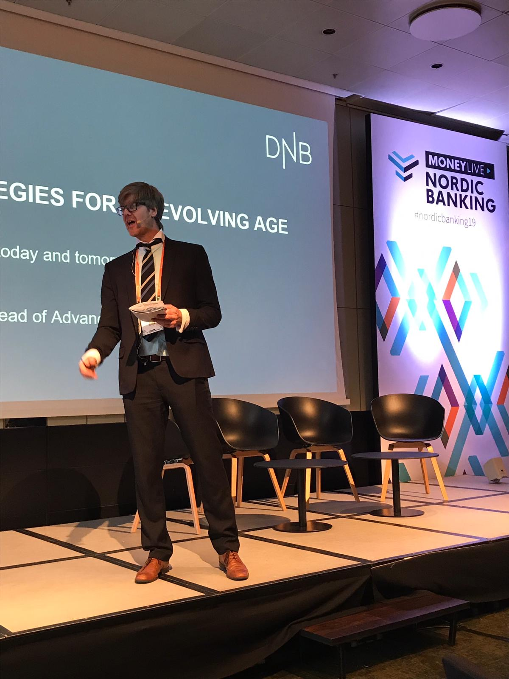
Peter Nordgaard
25 years as analysist, operations manager, CFO, COO and boardmember
25 years experience as educator at various universities such as Middlesex University London, German Business School, Hainan University, Hanoi University, Africa MBA, Copenhagen Business School etc.
14 years experience as boardmember and member of governmental boards
Specific interest in Sustainability, compliance and management control. Build compliance setup for i.e. bitcoin exchanges.
Investor in companies with two companies being sold in 2021
15 years as chairman of various internal conferences in the area of banking
https://www.linkedin.com/in/nordgaard/

Slide 3
Sustainability? ESG?
That is not relevant for me!"
Sustainability is hot, for customers and for the financial sector. There is just one issue.
What can I do?
How do we get an overview?
How can we implement ESG?
How can we support Circular Economy?
Are there revenues to be gained in Sustainability?

Slide 4
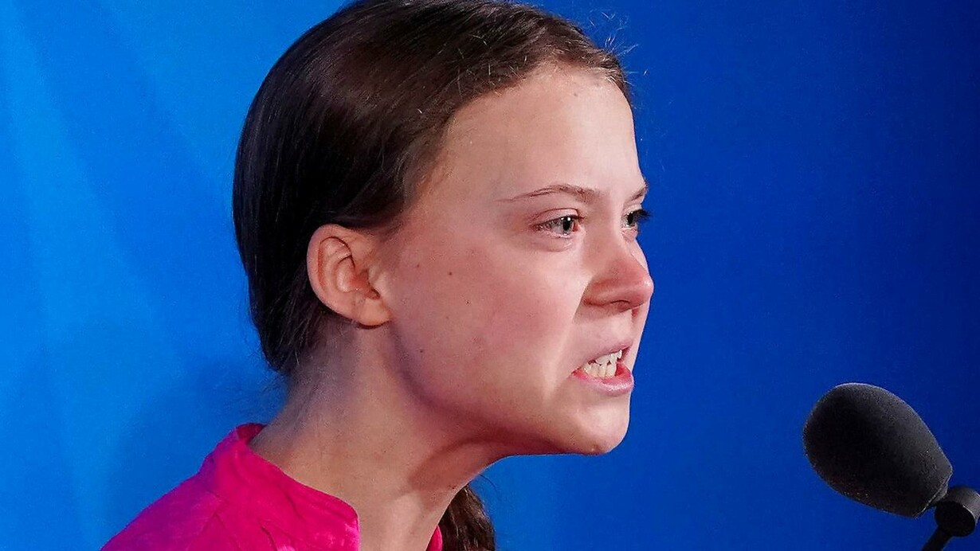
Traditionel Finance
The Financial Evaluation is about to change
This we define as the external use of ESG
The voice is getting stronger…
There is no wait and see…
Financial ROI
Risk
Taste
ESG
New Finance
(Fama and French, 2007; Hong and Kacperczyk, 2009; Pastor et al., 2020),

Slide 5
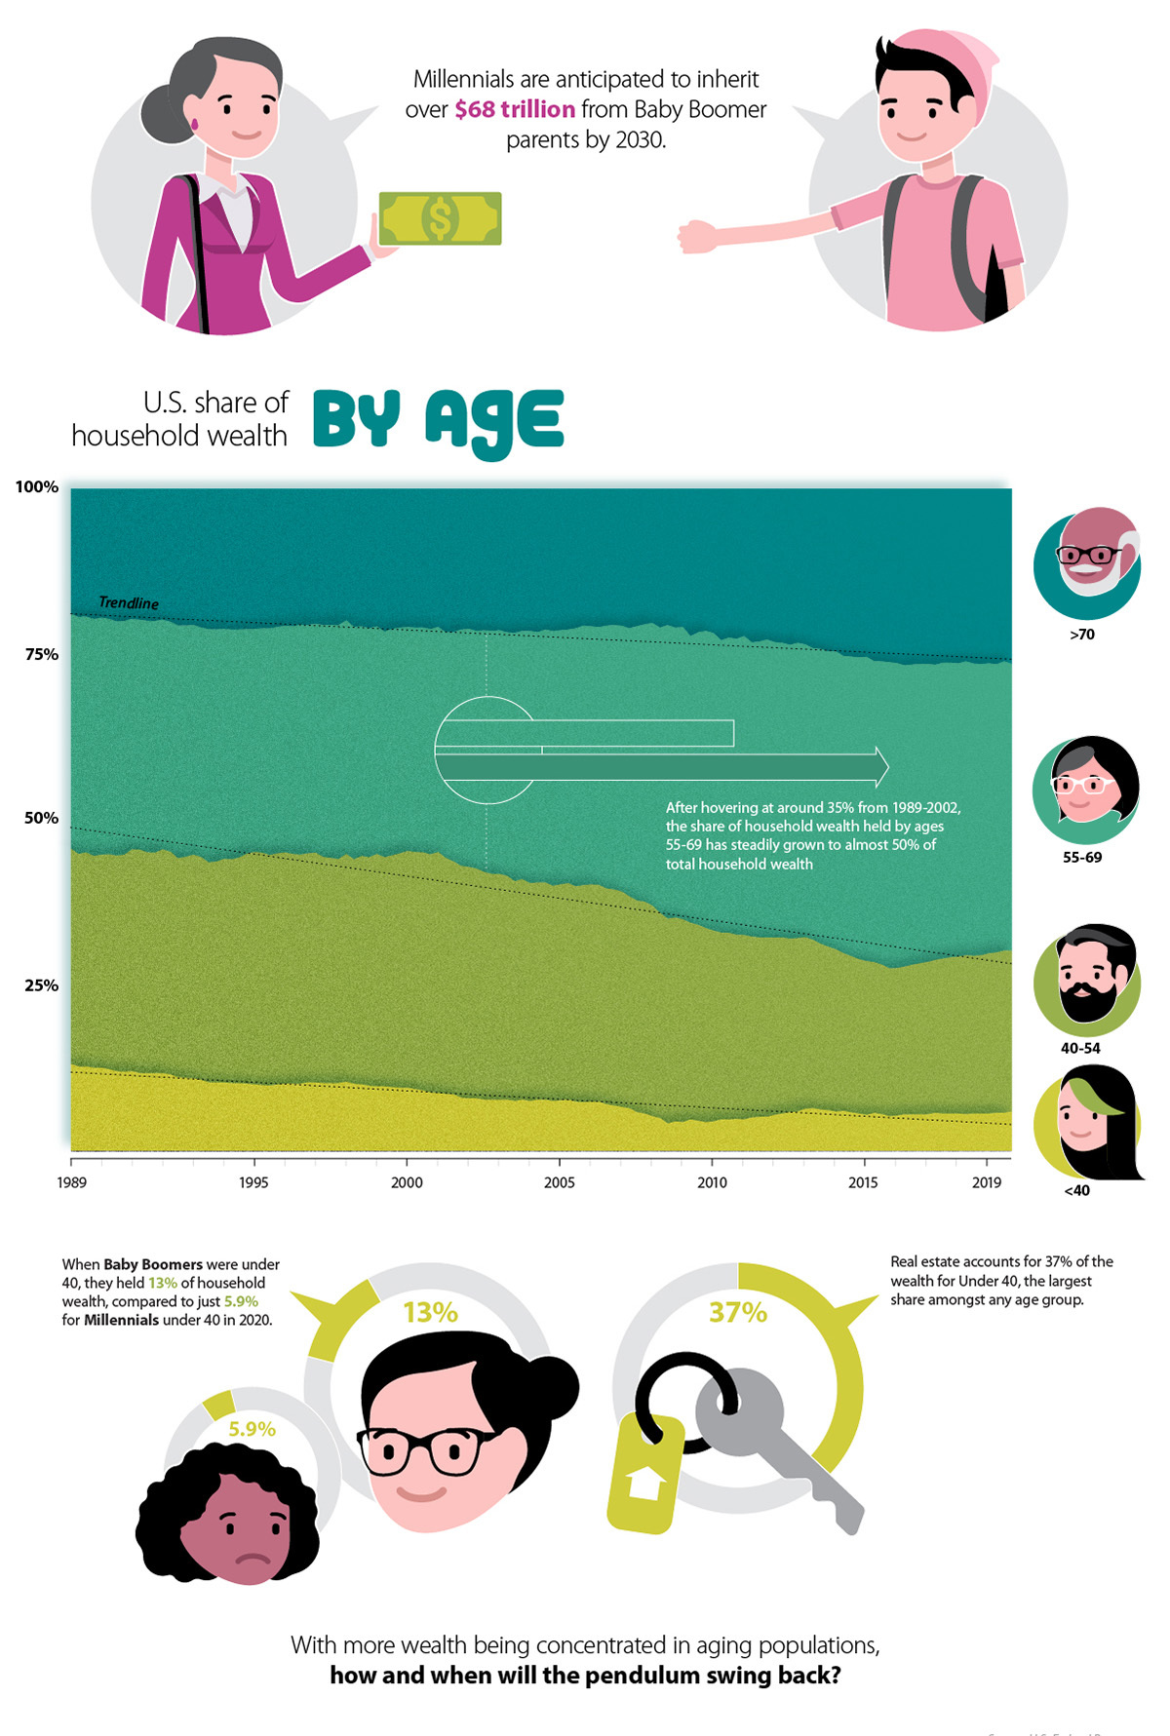
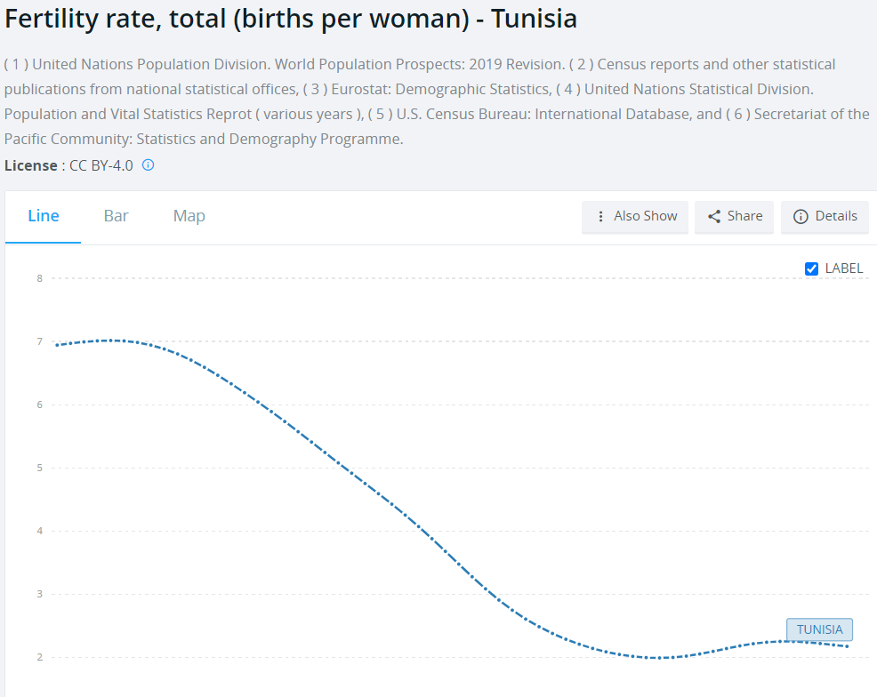
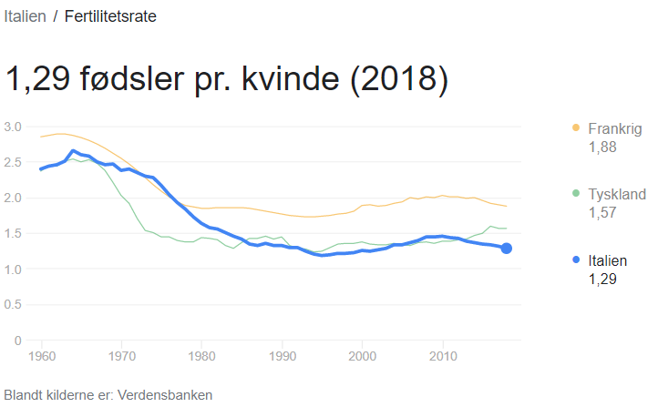
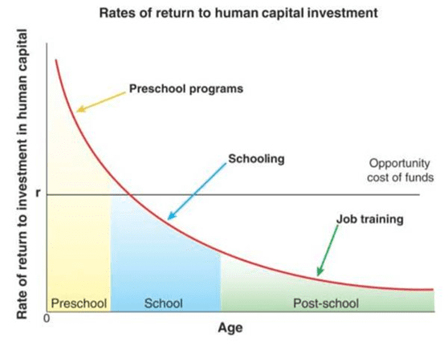
Macro examples
Wealth distribution
Human Capital Investment Efficiency
Heckman Curve
https://dors.dk/files/media/rapporter/2021/f21/endelig_rapport/f21_hovedkonklusioner.pdf

Slide 6
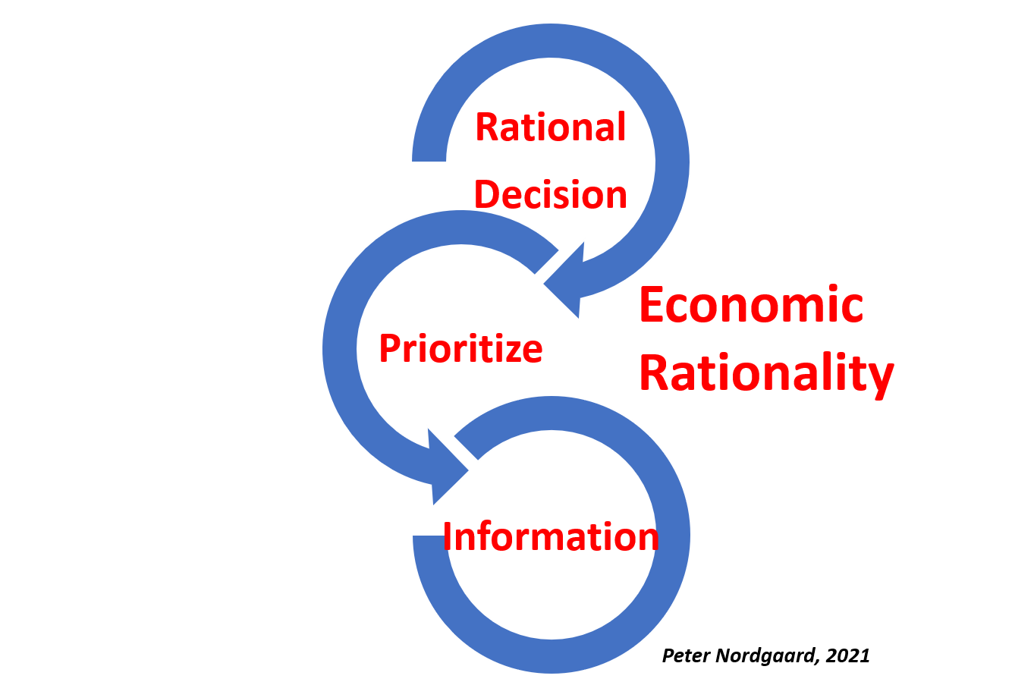
Economic Theory
The foundation of most economic theory are these three principles.
Without them economic reality is impeeded
Agency theory is an example of an impediment.
A director of a company, employed by the shareholders, may take decisions that favour himself
You just landed in Thailand and went to local market. What rationality parameters may be missing, when you buy your first product?
Behavioural economy is concentrated on behaviour, not rationality

Slide 7
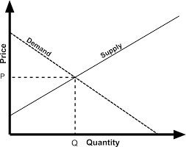

Equilibrium Price
The main principle in Economic theory is the idea of ”Markets clearing”
The idea is that the market economy, by itself, creates balance.
If more people wants electric cars, the demand curve will move upwards and price increases. Then it becomes attractive to produce electric cars, more producers surface.
Supply increases and price decreases.
The market takes care of everything
Equilibrium price: Quantity demanded equals quantity produced

Slide 8
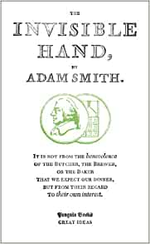

Welfare State
When something is for free, demand is endless.
There is thus no natural market mechanism to stop the welfare state. The demand for the Welfare state is endless. It is never fullfilled….
Adam Smith’s landmark treatise on the free market paved the way for modern capitalism, arguing that competition is the engine of a productive society, and that self-interest will eventually come to enrich the whole community, as if by an ‘invisible hand’.

Slide 9
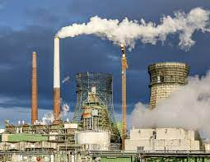
Externality/Free Rider
If something has the price of Zero, it will not display any value in calculations.
The usage will not be naturally diminished, as consumption is free
Free Rider
If investing in a good means that everyone else can enjoy without paying, would you really do it?

Slide 10
What Challenges do you see in your company?
In your surroundings?
In Tunisia?
If you were to decide, how would you prioritize our actions?
Please build a model and show me

Slide 11
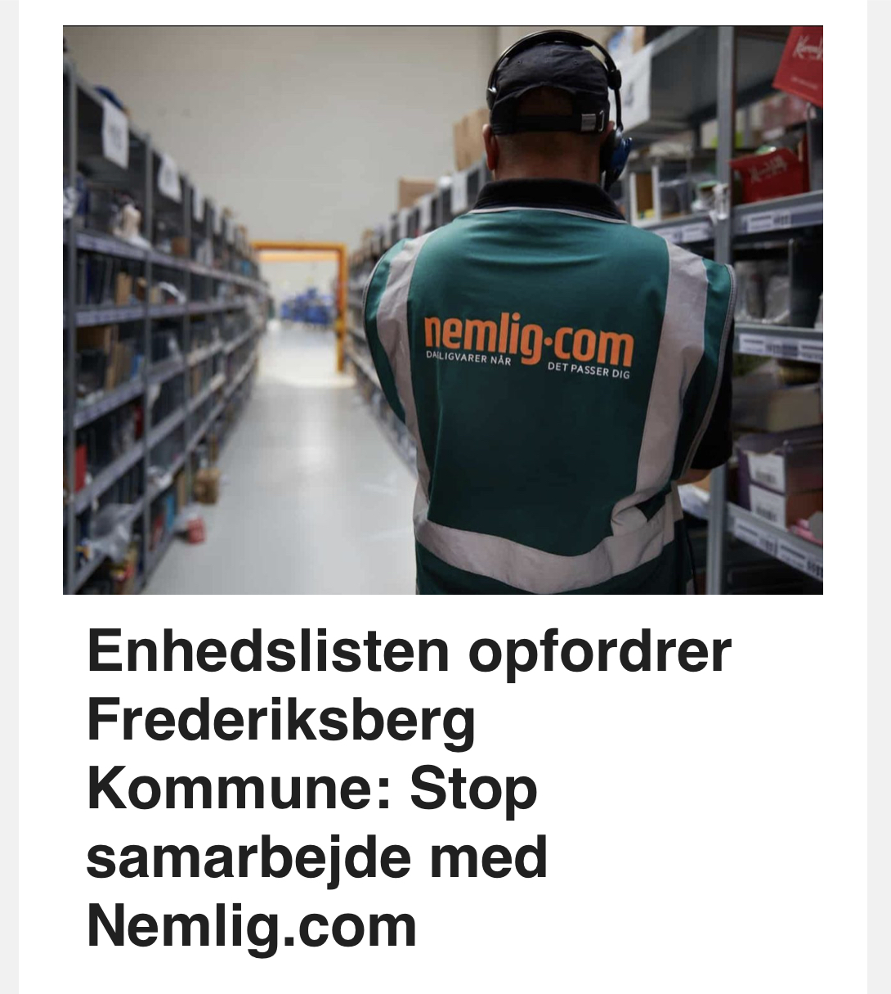
Market Failures – Social Efficiency
Rational Economic Behaviour
How are societies displaying social efficiency;
during Corona?
In fighting pollution?
In achiecing world wide prosperity?
In motivating people to produce for the common good
Who owns the patent for Insulin?
Who owns the patents for production methods?
What is the MC curve for producing Insulin
* Is the Singapore system for traffic congestion a good one?
´
Distribution of wealth
Social Efficiency
Externalities? Free rider?
”Tragedy of the Commons”?
Taxing – ”Race to the Bottom”?

Slide 12
Insulin
When inventor Frederick Banting discovered insulin in 1923, he refused to put his name on the patent. He felt it was unethical for a doctor to profit from a discovery that would save lives. Banting’s co-inventors, James Collip and Charles Best, sold the insulin patent to the University of Toronto for a mere $1. They wanted everyone who needed their medication to be able to afford it.
According to a 2017 Lancet paper on insulin price increases, “Older insulins have been successively replaced with newer, incrementally improved products covered by numerous additional patents.”

Slide 13
”ESG might be the biggest change ever to financial institutions!”

Slide 14
Financing is a strong driver
“Goldman Sachs, for example, announced they would spend US$750 billion on sustainable finance over the next decade.
Bank of America has pledged US$300 billion to sustainable investments³.
Virtually every large global bank has made some sort of commitment — both financial and otherwise.
The point is that the leaders are making ESG a CEO-level and Board-level mandate; they are elevating the issue to the highest levels of the organization.”
KPMG, 2021
ESG Investing
Sustainable
ETF
Green
Loans
(Green Loan Principles)
ESG Targets
Loans

Slide 15
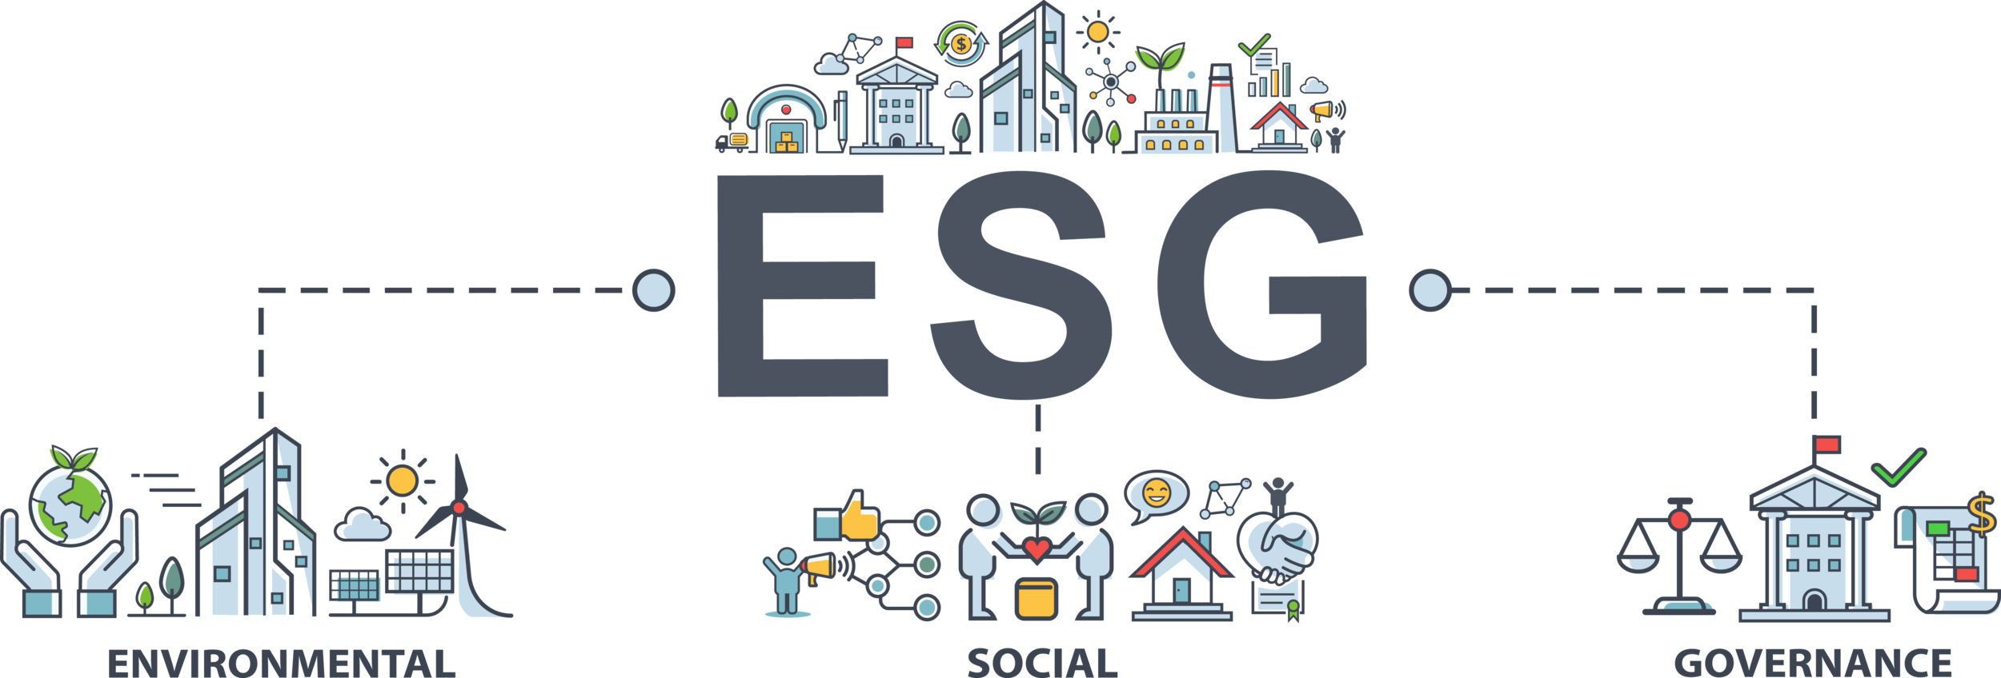
Overview What is ESG?
ESG Framework
Introduction
The history of ESG
Theoretical Framework
Regulatory trends
Industry Experiences
Consumption
Waste
Consequences
Relations
Decisions
”Around 30% of worldwide professionally managed assets are roughly 30 trillion USD”, Harward (2)

Slide 16


What are Green loans?

Slide 17

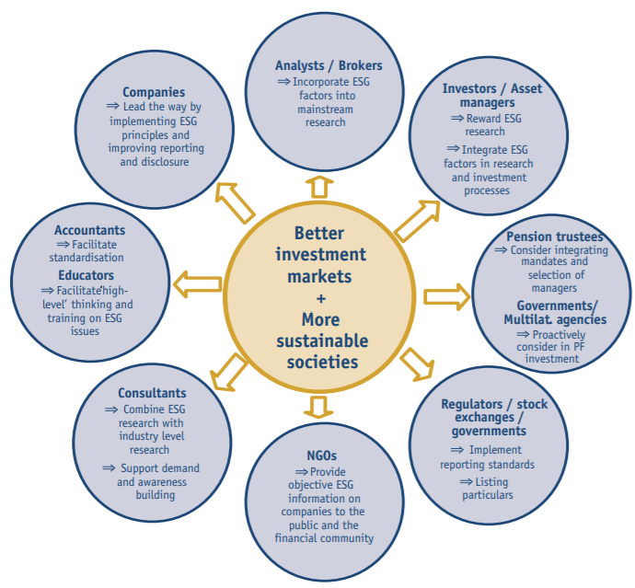

Overview What is ESG?
ESG Framework
Introduction
The history of ESG
Theoretical Framework
Regulatory trends
Industry Experiences
Consumption
Waste
Consequences
Relations
Decisions
Your Response to Climate Change, Workers, Innnovation and Trust
2005, SRI,

Slide 18

Reality versus intentions
“A Bloomberg analysis of over 70 sustainability-linked revolving credit lines and term loans arranged in the U.S. since 2018 shows that more than a quarter contain similar provisions: no penalty for falling short of stated goals, and only a minuscule discount if targets are met. Other companies that have widely publicized similar arrangements, including JetBlue Airways Corp. and Prudential Financial Inc., declined to disclose details of their loans.”,
https://www.bloomberg.com/news/articles/2021-09-08/esg-financing-comes-with-few-penalties-for-missing-goals
The latest development in the loan markets has been the broadening of KPIs to include social and governance goals beyond environmental ones—adding the “SG” to the leading “E”
https://www.torys.com/Our%20Latest%20Thinking/Publications//2021/03/trends-in-esg-loans/
Please describe what is a Green Loan?
How could this change the work of financial institutions?
Who would benefit? Why?
“critics say more and more companies are presenting overly polished images of both their commitments and results.”

Slide 19
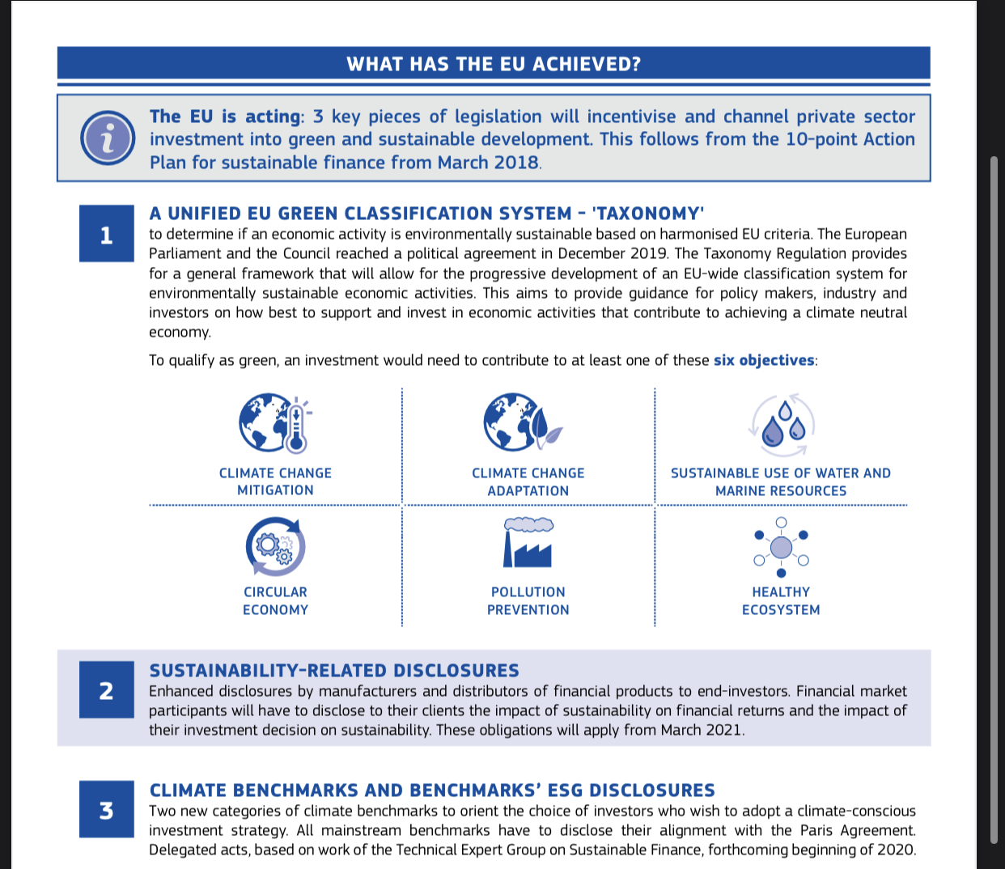
EU Intentions
Climate Change Mitigation
Climate Change Adaptation
Sustainable use of water
Circular Economy
Pollution Prevention
Healthy Ecosystem

Slide 20
Sustainability
”Not relevant for me”
ESQ in Financial Institutions
Day II Tunis, Jan 2022
Peter Nordgaard
Instagram https://www.instagram.com/learnycint/
Linkedin: https://www.linkedin.com/in/nordgaard/?locale=da_DK
Facebook: Peter Nordgaard
Whatsapp +45 31 71 31 07
https://www.linkedin.com/in/nordgaard/

Slide 21
My Prediction!
”These two days we are training what everybody else will try to train you in, the next two years!”
Peter Nordgaard

Slide 22
The real Environmental Question!
Green Energy
Reusable
Materials
Low Transport
Production
Long Lifetime
Shareable
Flexible
Consumption
Peter Nordgaard, 2021
How could this impact companies?
Does it reveal new revenue models also?

Slide 23

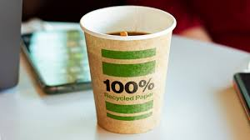

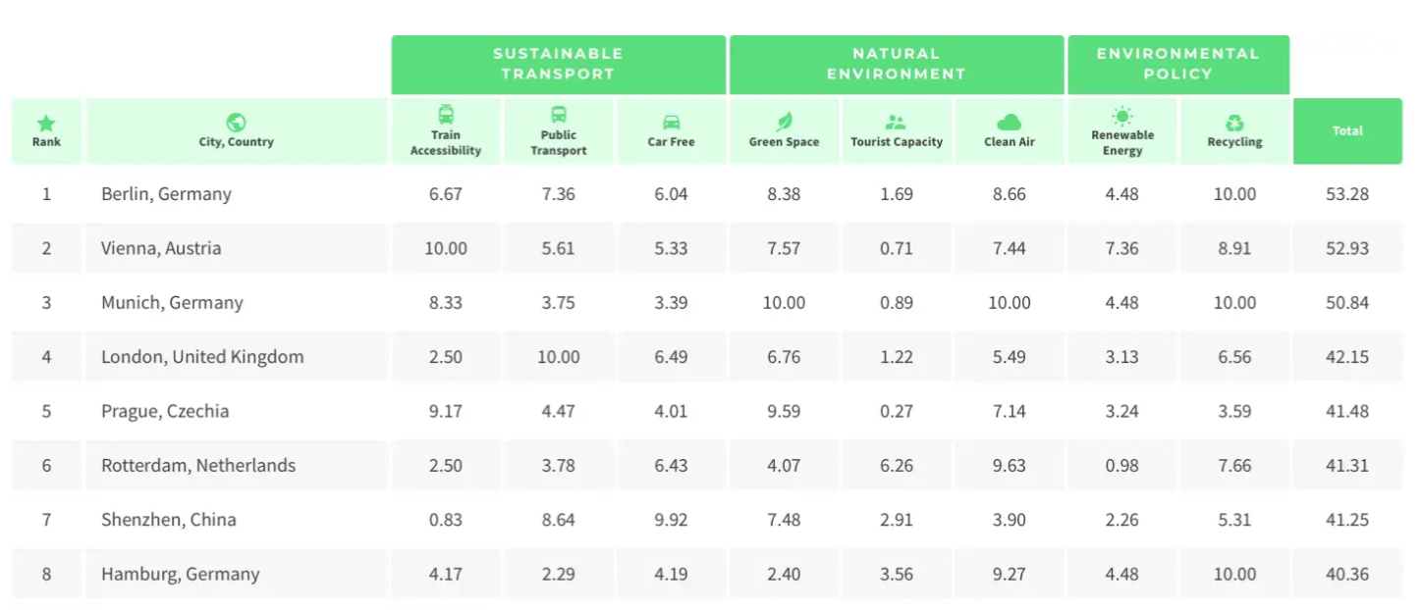
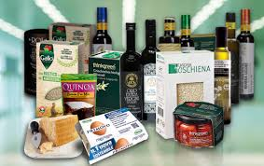
New Business MOdels
Marketplaces for sharing
Premium Price Products

Slide 24



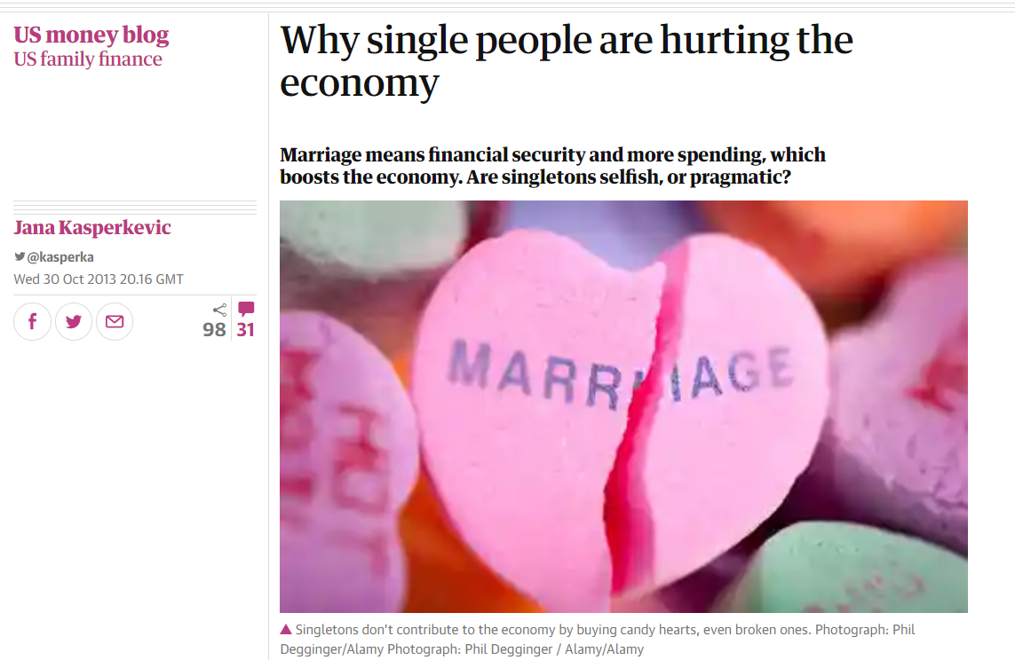
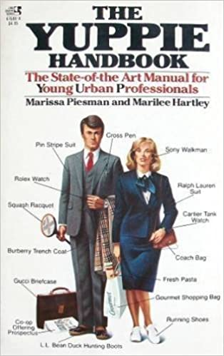
Financial Concepts in real life!
Minimalism
Think about everything you learned so far
1. What economical concepts do you recognize in the podcast about dating?
2, Pick another lifestyle trend and explain its impact on economy!

Slide 25
Taxonomy - Models
To be able to work with reality, we try to compress reality into models
To work with complex measures like ESG, working with models is evident
Porters Five Forces
VRIO
Pestel
Balanced Scorecard
Etc.
Academically we use models to describe the reality in a more simple way

Slide 26
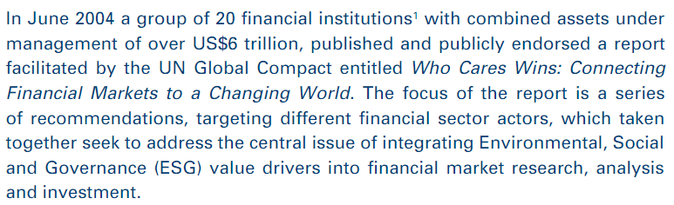
ESG History
Globalisation is happening at a breathtaking speed and the world is truly moreinterconnected -> what is happening in terms of social and environmentaltrends in China or Brasil or in any part of the world is not irrelevant to WallStreet anymore• We are all awakening to the fact that fossil fuel reserves are limited and thatclimate change is truly happening -> this means huge systemic changes inour economies, leading to both risks but also considerable opportunities forinvestors
they are walking the talk, but it is not institutionalised

Slide 27
Greenhouse Gas Protocol
The GHG Protocol Corporate Standard focuses only on the accounting and reporting of emissions.
Relevance
Completeness
Consistency
Transparency
Accuracy
Value Chain

Slide 28
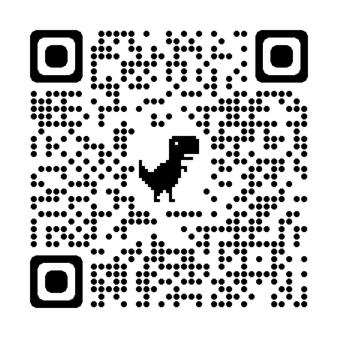
Your Carbon Footprint
What can you do?
What will you do?
What will you do in your job position?

Slide 29
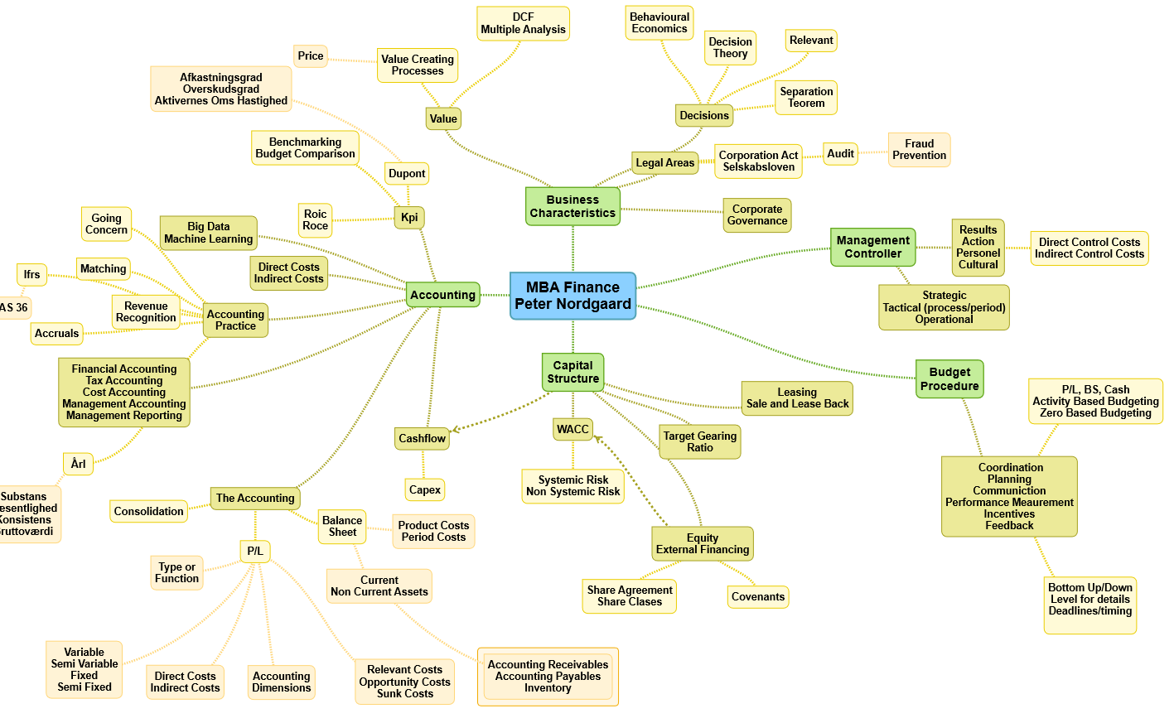
Yesterday
What did we learn yesterday?
Macro
Changes
Economic
Principles
Market Failures
Green Loans
Regulatory
Initiatives

Slide 30
The real Environmental Challenge!
Green Energy
Reusable
Materials
Low Transport
Production
Long Lifetime
Shareable
Flexible
Consumption
Peter Nordgaard, 2021
Circular Economy is the idea of minimizing waste in all possible ways
It requires new ways of designing products, new revenue models and new usage patterns

Slide 31
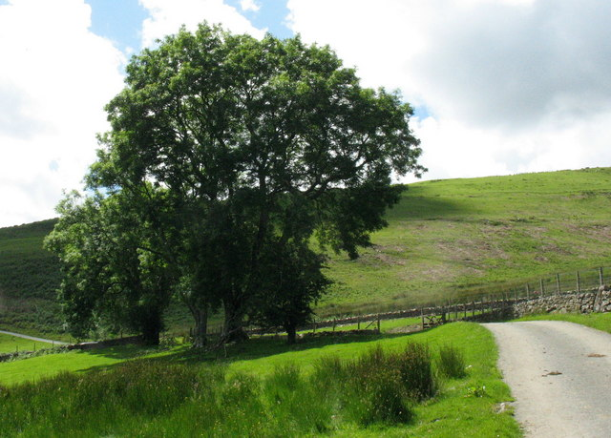
Overview Step One
Prepare
Develop
Impact
Inform
Prepare
Interest
Analyse your key partners
Risk Assessment
Plan and develop
Expect Movements

Slide 32

Interest Group Analysis
‘Made in Tunisia’: the worker-casualties of the globalisation of the textile industry

Slide 33

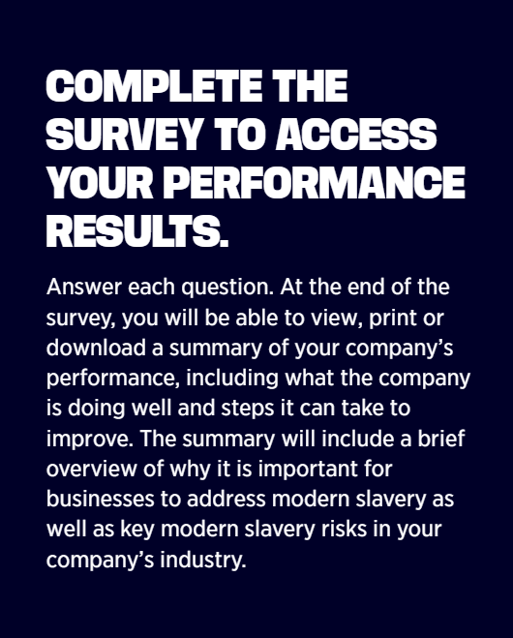
Working with ”S” (Social)
Slavery Survey
the quality of trying to include many different types of people and treat them all fairly and equally:

Slide 34
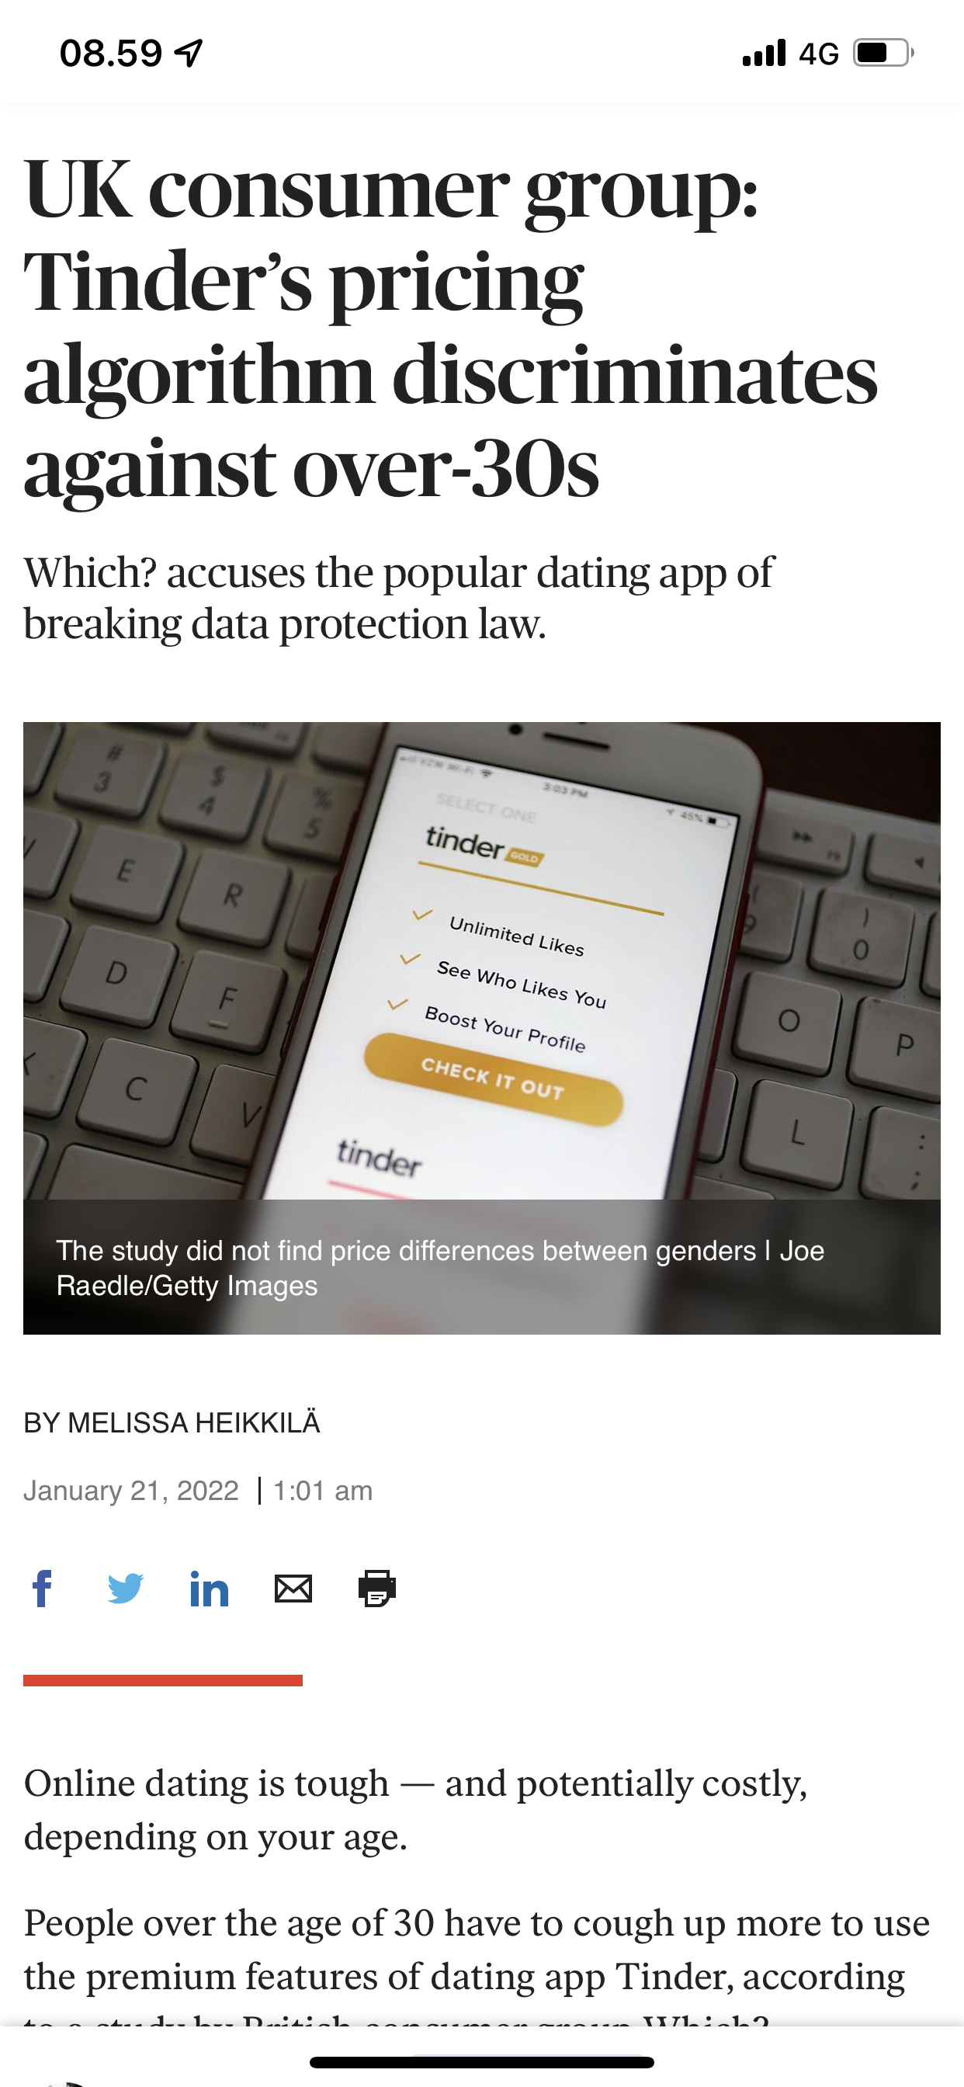
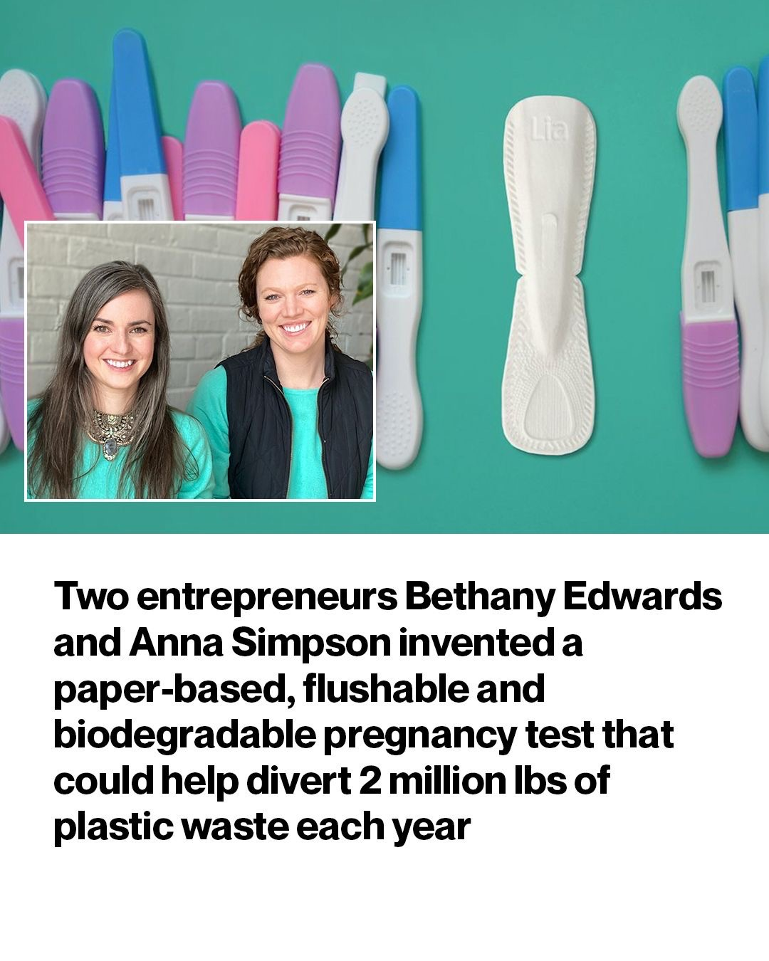

Slide 35
Risk Management
Identify
Risk
Categorize
Risk
Risk Mitigation
Choose Risk Level

Slide 36

Managing
Risks

Slide 37
Overview What is ESG?
ESG Framework
Introduction
The history of ESG
Theoretical Framework
Regulatory trends
Industry Experiences
Consumption
Waste
Consequences
Relations
Decisions
Your Response to Climate Change, Workers, Innnovation and Trust
2005, SRI,

Slide 38
Overview – How do we measure?
The problems of;
overlapping investment
product categorization
non-standardized terminology
greenwashing are unlikely to be fully addressed by a single solution
Carbon Footprint
Energy Efficiency Improvement
Employee health & Safety
“In addition, the terminology associated with incorporating ESG approaches into investment products is not standardized”, CFA 2021
https://www.carbonfootprint.com/calculator.aspx

Slide 39
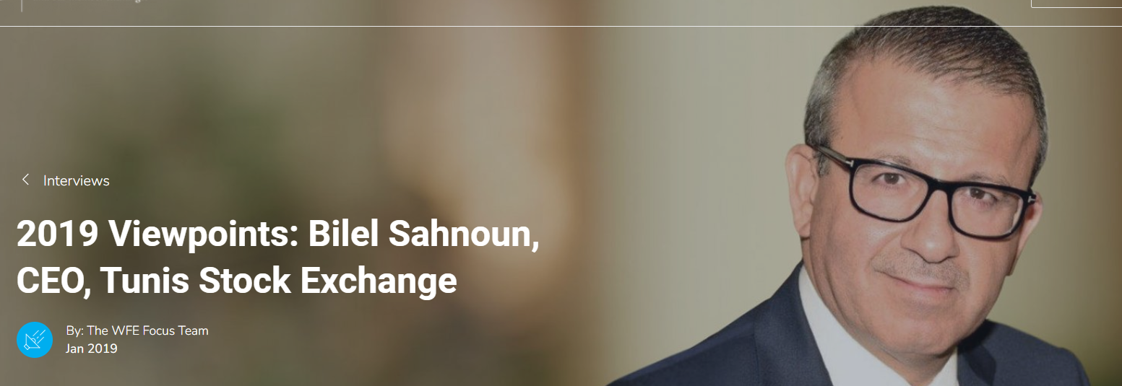

ESG Guide
05.12.2021
The WFE’s Sustainability Principles (launched in October 2018) and its annual environmental, social & governance (ESG) survey show us that more and more exchanges and CCPs are taking a leadership role in promoting the sustainable finance agenda. How is your business taking a more sustainable approach to the financial system?
“Regarding ESG issues, the Tunis Stock Exchange is the pioneering institution in the Tunisian financial system. In 2015, we joined the Sustainable Stock Exchanges (SSE) Initiative, a UN partner programme. We are widely acknowledged to be a key promoter of ESG issues and sustainable investment. We are confident about our capability to play a key role in driving ESG and sustainable finance awareness in the financial system. An important law was recently enacted in Tunisia to require companies to earmark resources to fund ESG activities and to report on these activities.”

Slide 40
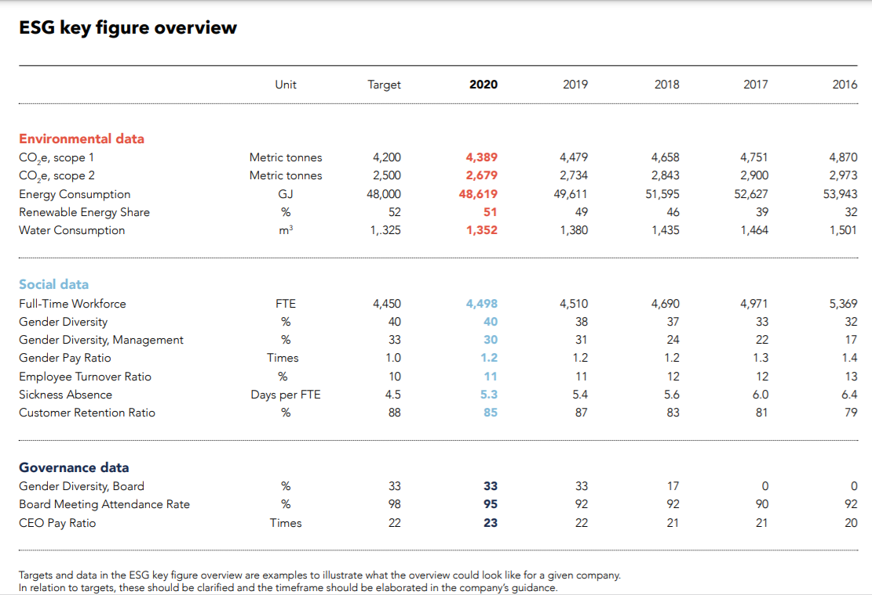
CFA Official ESG measures

Slide 41
Measurement Difficulties
Implied Casuality
(Women on board)
Creating Unintended
Consequences
(Car emissions versus trucks)
Easy measures win
(CO2 versus Biodiversity)
Zoom in to develop insights
Zoom out to see the big picture – water versus CO2
Be curious

Slide 42

Strategy
Peter Nordgaard
Strategy Guide

Slide 43
Measurement Guidelines
Complete
Full Disclosure
• Complete. Investment product ESG disclosures fully disclose information that investors need in order to understand the investment product’s ESG approaches. Significant information is not omitted.
• Reliable. Investment product ESG disclosures fairly represent the investment product’s ESG approaches. Investment product ESG disclosures are not false or misleading.
• Consistent. Investment product ESG disclosures agree with, and supplement, regulatory disclosures and marketing materials.
• Clear. Investment product ESG disclosures are sufficiently specific and precise to effectively communicate to investors the investment product’s ESG approaches.
• Accessible. Investment product ESG disclosures are readily available to investors.
Reliable
Fair Presentation
Consistent
Regulatory/
Marketing
Clear
Specific/Precise
Accessible
Available

Slide 44
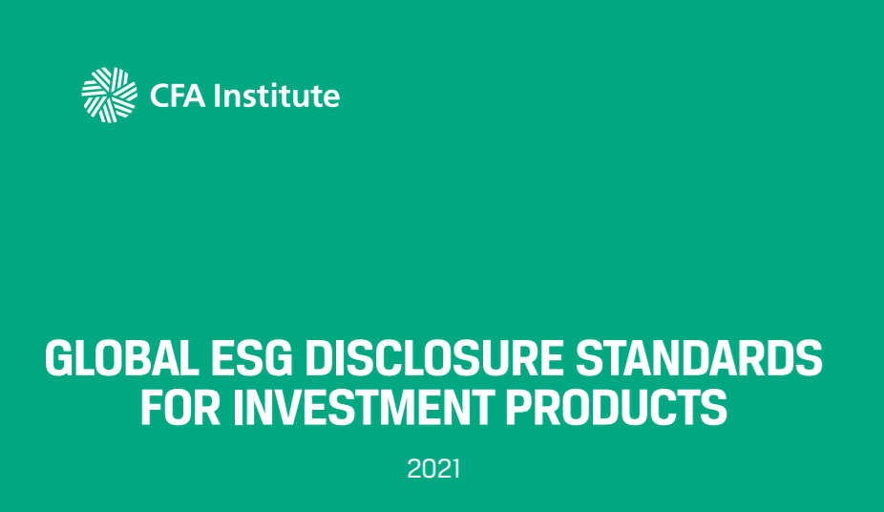
Example IMplementing
Objectives
Measureable
Beneficiaries
Time Horizon
Relationships &
Tradeoffs
Proportion
Risk
Measurement
Targets for each investment
Stewardship
Side Effects
CFA, World Standard, 2021

Slide 45

Novo ESG

Slide 46
Group Exercise
Group 1 is the Company Zara in Tunisia
You have to prepare the ESG for the Company
This is to be handed in to me.
You will prepare principles, rather than actual figures
Group 2 will audit the ESG presented by Group 1
The group will prepare the Audit concerns.
This is to be handed in to me
You will audit principles, rather than figures, by i.e. suggesting other figures
Both Groups have around 1 hour for preparing
Group 1 will present their ESG in 30 min (max)
Group 2 will then ask questions/audit to the presented ESG (30 min)

Slide 47
ESG Group 1
E
Energy
Waste
Carbon Footprint
S
Code of conduct
Equality
Diversity
Inclusion
Income/Incentives
Worklife Balance
Compliance Tools
G
Strategy
Business Plan
New Businessmodel
Compliance Function
Boardmeeting
Diversity/Inclusion
Audit

Slide 48
Sustainability? ESG? That is not relevant for me!"
Sustainability is hot, for customers and for the financial sector. There is just one issue.
How do we get an overview? Analysis of actors
How can we implement ESG? Guidelines and Standards
How can we support Circular Economy? New Ways of Thinking
Are there revenues to be gained in Sustainability? New Revenue Models
Peter Nordgaard
Instagram https://www.instagram.com/learnycint/
Linkedin: https://www.linkedin.com/in/nordgaard/?locale=da_DK

Slide 49
Article Notes
Time to Rethink the ”S” – Factors within S, modern supply chain issues, product quality impact business and destroy value. Should it be called Stakeholder instead. There is a lack of understanding for the ”S”. Measures are often vague. Covid 19 has made the society interested in S
2. ESG Measuring – six principles
3. Tunis Stock Exchange
4. Strategic Approached
5. Strategic Risk Management

